Slide 1


Content Filter
FCIS-ASU
Computer Science
2023-2024
Dr Donia Gamal
TA Lamis Hassan

Slide 2
Team Members
Andrew Adel Andrews
Veronica Emad William
Mehrael Ashraf Rahif
Monica Sameh Azer
Mariz Erian Ibrahim
Filobateer Essam Motamed
02

Slide 3
Table of contents
01
02
03
05
06
07
04
Introduction
System Architecture
Data Preparation
Preprocessing
08
Applied Models
Experiments
& Results
Integration
& Demo
Conclusion
& Future Work & References
03

Slide 4
01
Introduction

Slide 5
Introduction
Problem Definition
The internet is essential in everyday life but also contains harmful content, particularly with social media platforms being increasingly utilized for activities such as cyberbullying and hate speech.
Motivation
Our motivation is to help create a safer environment for our vulnerable users that do not wish to be exposed to this type of inappropriate and violent content.
05

Slide 6

Introduction
Aim
The project aims to block cyberbullying, violence, and inappropriate content while allowing access to legitimate material.
Objective
Objectives include creating a background tool to filter text and images, using advanced machine learning for real-time application and addressing biases to ensure fair treatment of diverse perspectives.
06

Slide 7
02
System Architecture

Slide 8
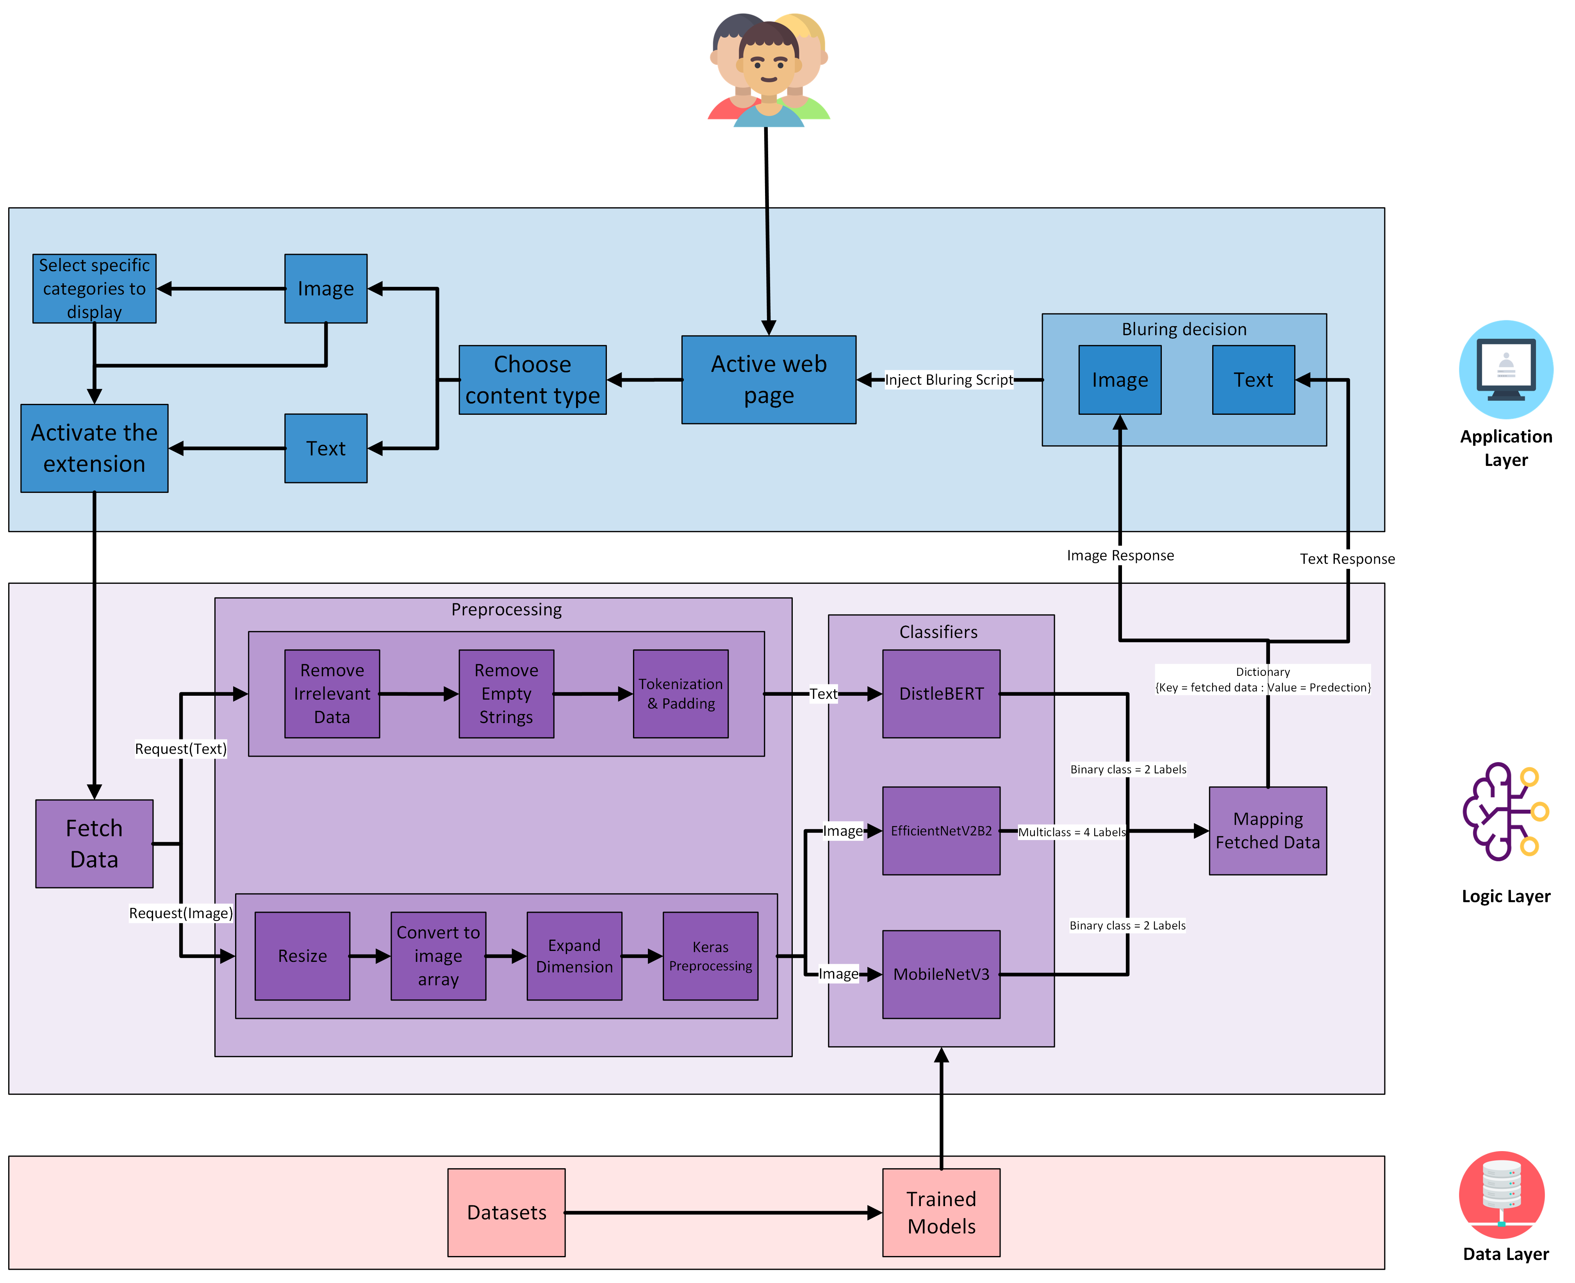
System Architecture
08

Slide 9
System Architecture: Application Layer
09

Slide 10
System Architecture : Logic Layer
10

Slide 11
System Architecture : Data Layer
11

Slide 12
Data Preparation
03

Slide 13










Text Binary Classification
Cyberbullying, hate speech, offensive…
Binary Image Classification
Violence & Non-violence
Multiclass Image Classification
Fire, accidents, damaged buildings & normal content
13

Slide 14
Binary Text Dataset
Category | Datasets | Number of used records | Our Dataset
Inappropriate content | Cyberbullying dataset (aggression) [1] | 14782 records | 167,051 records
 | Cyberbullying dataset (kaggle) [1] | 2806 records
 | Tweets 1 [2] | 20620 records
 | Toxic comments detection (Balanced) [3] | 89363 records
 | Toxic comments detection (Classified comments) [3] | 39480 records
Appropriate content | Cyberbullying dataset (aggression) [1] | 101082 records | 165,669 records
 | Cyberbullying dataset (kaggle) [1] | 5993 records
 | Tweets 1 [2] | 4163 records
 | Toxic comments detection (Balanced) [3] | 100513 records
 | Toxic comments detection (Classified comments) [3] | 102425 records
14
Notes:
Our dataset is merged from 5 different datasets.

Slide 15


Challenges & How we solved them
Some datasets contained abbreviated slang words (lol, asap).
It also contained irrelevant content such as days, month, mentions, links, etc.
Most of the datasets were imbalanced.
Searched for a dataset that contains the original words of the slang words abbreviation.
Created a dictionary to replace them with their original words.
Ex: lol = laughing out loud, asap = as soon as possible.
Removed irrelevant content by
Creating a list of short and long version of each word.
Ex: Mon = Monday, Apr = April.
Used regular expression to remove these special characters .
Applied down sampling as a balancing technique.
15

Slide 16

Binary Image Dataset
Category | Datasets | Number of used images | Our Dataset
Violence | Real Life Violence and Non-Violence Data [4] | 5832 images | 11,674 images
 | Violence vs. Non-Violence: 11K Images Dataset [5] | 5842 images
Non-Violence | Real Life Violence and Non-Violence Data [4] | 5231 images | 10,462 images
 | Violence vs. Non-Violence: 11K Images Dataset [5] | 5231 images
Both datasets were clean and devoid of significant issues.
However, to enhance the deep learning model's performance, the decision was made to merge them.
By combining the datasets, we capitalized on their strengths, resulting in a more diverse and effective training set.
16
Notes:
Our dataset is merged from 2 different datasets.

Slide 17
Multiclass Image Dataset
Category | Dataset | Number of used images | Our Dataset
Fire | Cyclone Wildfire Flood Earthquake Database [6] | 1077 images | 16,289 images
 | Forest Fire [7] | 1022 images
 | The wildfire dataset V2 [8] | 730 images
 | Forest_Fire_Smoke_and_Non_Fire_Image_Dataset [9] | 10800 images
 | Wildfire_surveillance [8] | 2580 images
Normal | The wildfire dataset V2 [8] | 1157 images | 17,098 images
 | Fire Images Database [10] | 3952 images
 | FOREST FIRE IMAGE DATASET [11] | 7139 images
 | Wildfire_surveillance [8] | 2580 images
Accidents | AIDER [12] | 485 images | 16,011 images
 | Accident detection | 1675 images
 | Augmented image from (Traffic-Net dataset) | 13850 images
Damaged Buildings | RescueNet [13] | 3595 images | 15,250 images
 | Cyclone Wildfire Flood Earthquake Database [6] | 1350 images
 | AIDER [12] | 511 images
 | Augmented Images from all previous datasets in this category | 4164 images
 | Extracted buildings images from (Ukraine Images 2023) [14] | 5630 images
17
Notes:
Our dataset is merged from 2 different datasets.

Slide 18
Multiclass Image Dataset
Category | Dataset | Number of used images | Our Dataset
Fire | Cyclone Wildfire Flood Earthquake Database [6] | 1077 images | 16,289 images
 | Forest Fire [7] | 1022 images
 | The wildfire dataset V2 [8] | 730 images
 | Forest_Fire_Smoke_and_Non_Fire_Image_Dataset [9] | 10800 images
 | Wildfire_surveillance [8] | 2580 images
Normal | The wildfire dataset V2 [8] | 1157 images | 17,098 images
 | Fire Images Database [10] | 3952 images
 | FOREST FIRE IMAGE DATASET [11] | 7139 images
 | Wildfire_surveillance [8] | 2580 images
Both categories were clean and free of significant issues.
18

Slide 19
Multiclass Image Dataset
Category | Dataset | Number of used images | Our Dataset
Accidents | AIDER [12] | 485 images | 16,011 images
 | Accident detection | 1675 images
 | Augmented image from (Traffic-Net dataset) | 13850 images
Damaged Buildings | RescueNet [13] | 3595 images | 15,250 images
 | Cyclone Wildfire Flood Earthquake Database [6] | 1350 images
 | AIDER [12] | 511 images
 | Augmented Images from all previous datasets in this category | 4164 images
 | Extracted buildings images from (Ukraine Images 2023) [14] | 5630 images
19

Slide 20
Challenges & How we solved them
Not enough data available.
Available datasets were very small.
Other datasets were video frames and didn’t have scene varieties
Extracted the good images from the available datasets.
Resized the images to dimensions of 224x224 pixels as a preparatory step for utilization with pretrained models.
Applied data augmentation on the extracted images to increase the size of the dataset.
Combined all the found images and the augmented ones into one dataset.
20

Slide 21
Preprocessing
04

Slide 22
Text Preprocessing
We created a preprocessing pipeline to remove any irrelevant data from our dataset by removing numbers, symbols, and any symbols related specially for our dataset, like mentions and retweets.
Text Cleaning
Replaced any abbreviated words present with their elaborated versions to try and capture the full meaning behind the text.
Remove Abbreviations
Splitting Data
Split the dataset into
Train: 60%
Test: 20%
Validation: 20%.
Used DistilBERT preprocessor with the preset data that contains a tokenizer and pads the text.
Preprocessor
22

Slide 23
Binary Image Preprocessing
Splitting Data
Used keras internal module to generate our images form our dataset directory.
The main benefit of using this approach is that it perform basic data augmentation like rotation, flipping, etc., which helps in improving model generalization, also it can work with the RGB Images.
Split the dataset into
Train: 60%
Test: 20%
Validation: 20%.
Keras Internal Module
Resizing
We also resized our images to 224 x 224.
23

Slide 24
Multiclass Image Preprocessing
Splitting Data
Split the dataset into
Train: 70%
Test: 20%
Validation: 10%.
we used keras ImageDataGenerator to generate our images while using efficientnet_v2 preprocessor as the preprocessing function.
Keras ImageDataGenerator
efficientnet_v2
The main benefit of using efficientnet_v2 is that it applies Normalization to the data and can work with the RGB Images.
Resizing
We also resized our images to 224 x 224.
24

Slide 25
Applied Models
05

Slide 26
Applied Models
Text Model
Binary Image Model
Multiclass Image Model
DistilBERT Transformer [15]
Most efficient version of BERT to work with real-time data.
MobileNetV3 [16]
This model seamlessly integrated into our system, delivering exceptional speed and efficiency.
EfficientNetV2B2 [17]
The most lightweight model that ensures expedited and effective performance.
26

Slide 27
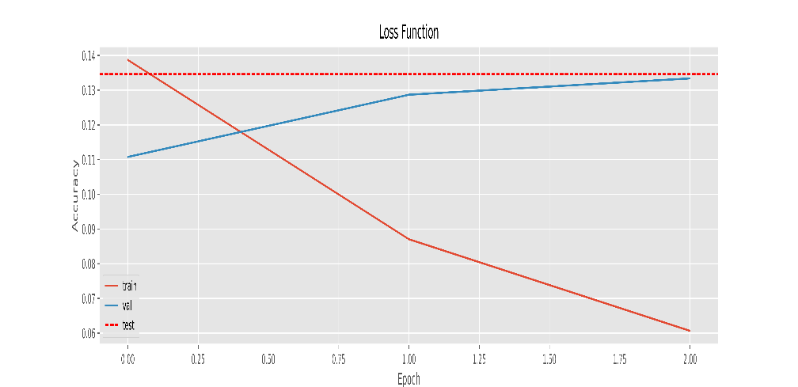
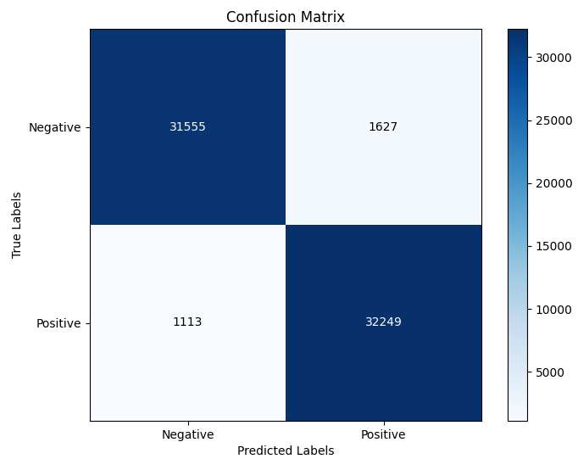
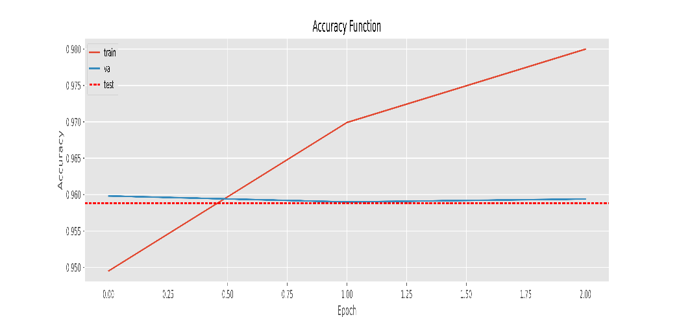
DistilBERT Transformer
27

Slide 28
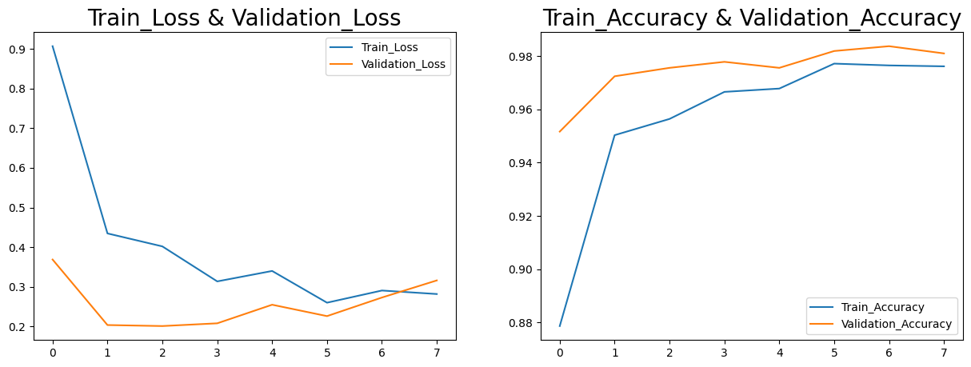
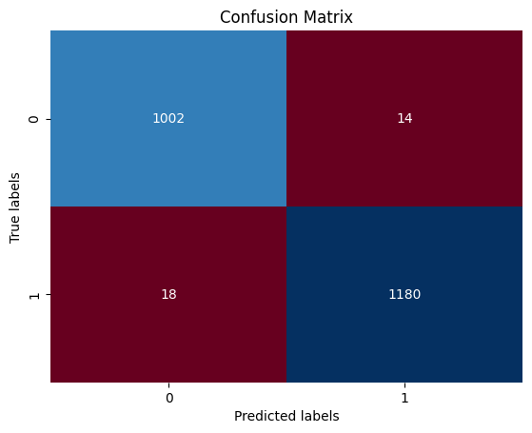
MobileNetV3
28

Slide 29
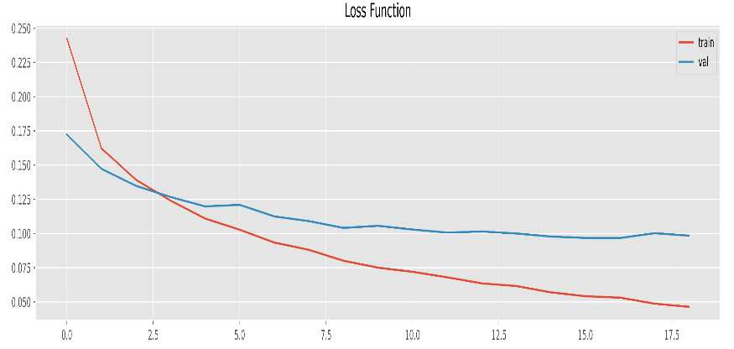
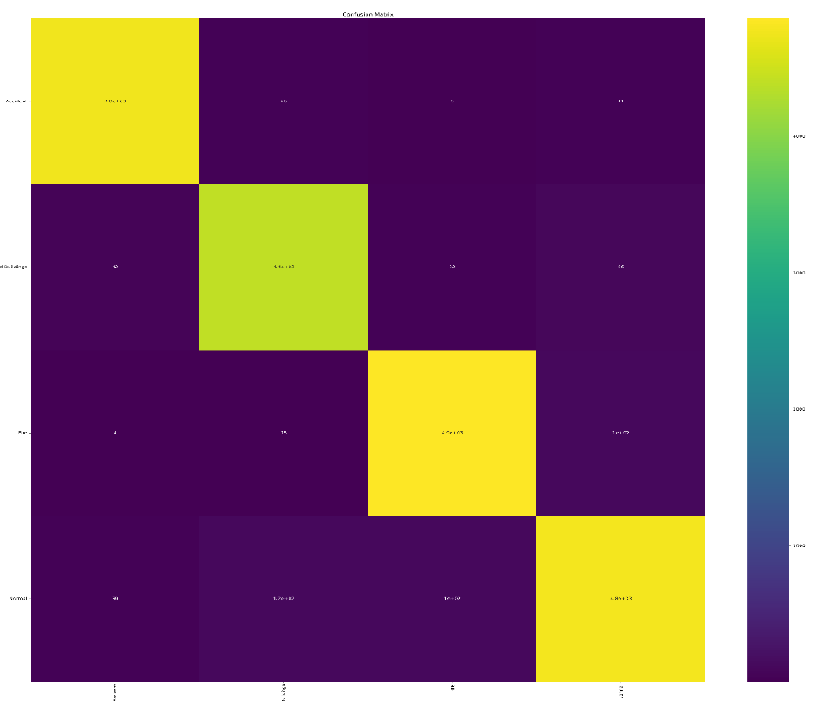
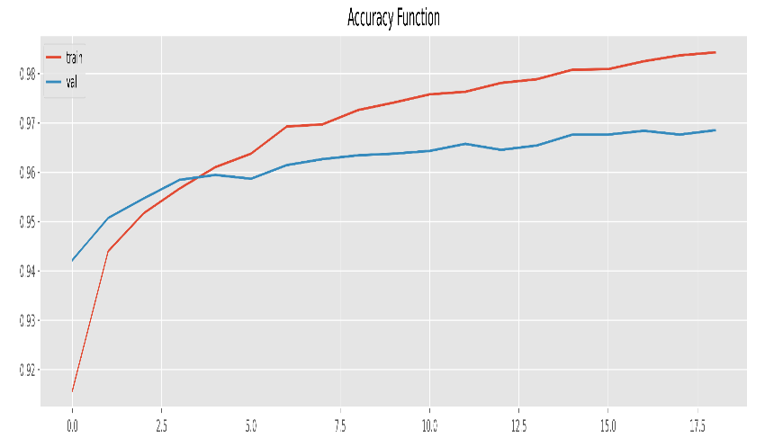
EfficientNetV2B2
Confusion Matrix
Accident
4.8e+03
26
6
41
4000
Damaged
Buildings
42
4.4e+03
32
86
3000
Actual
Fire
2000
4
15
4.9e+03
1e+02
1000
Normal
39
1.2e+02
1e+02
4.8e+03
Damaged
Buildings
Fire
Normal
Accident
29
Predicted

Slide 30
Experiments & Results
06

Slide 31
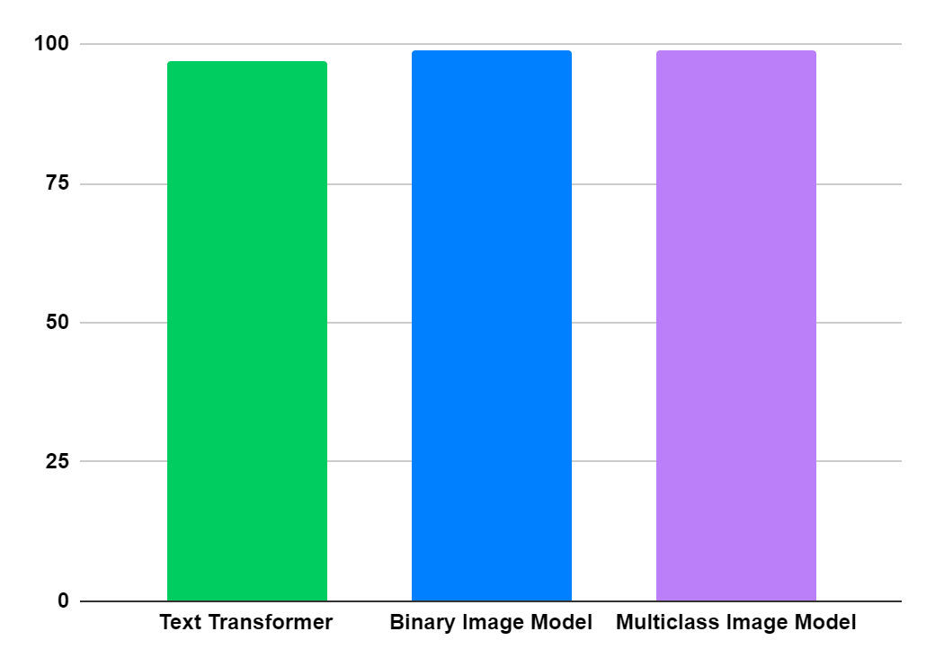
Exploring Diverse Model Approaches
Binary Image Model
Multiclass Image Model
Text Transformer
Tried different traditional, modern and deep learning approaches.
Applied suitable preprocessing techniques foreach model to enhance it.
Applied hyperparameter tunning to improve models' performance.
Documented each experiment.
Accuracy
31

Slide 32
Binary Text Models Results
Model | Number of epochs | Train Accuracy | Train Loss | Validation Accuracy | Validation Loss | Test Accuracy | Test Loss
RoBERTa | 3 | 97.9% | 0.055 | 96.97% | 0.1031 | 96.89% | 0.1022
DistilBERT | 3 | 98.4% | 0.045 | 96.78% | 0.1061 | 96.78% | 0.1095
BERT | 3 | 98.3% | 0.047 | 96.6% | 0.1092 | 96.63% | 0.1083
FNet | 4 | 98.7% | 0.037 | 96.46% | 0.11 | 96.45% | 0.11
32

Slide 33
Binary Image Models Results
Model | Number of epochs | Train Accuracy | Train Loss | Validation Accuracy | Validation Loss | Test Accuracy | Test Loss
ResNet50 | 40 | 99.48% | 0.0284 | 98.8% | 0.0504 | 98.8% | 0.0503
MobileNetV3 | 10 | 98.78% | 0.2812 | 98.87% | 0.9846 | 98.55% | 0.1699
EfficientNetB0 | 40 | 97.6% | 0.0671 | 97.34% | 0.0702 | 97.3% | 0.0702
VGG19 | 27 | 94.7% | 0.1451 | 94% | 0.1491 | 94.6% | 0.1413
DensNet121 | 40 | 91.6% | 0.2140 | 90% | 0.2664 | 91.9% | 0.2165
MobileNetV2 | 40 | 89.48% | 0.2528 | 89.75% | 0.2570 | 89.74% | 0.2569
Xception | 27 | 85.15% | 0.3617 | 78.8% | 0.4223 | 84.4% | 0.3422
AlexNet | 20 | 80% | 0.5149 | 79.7% | 0.6003 | 79.7% | 0.6002
NASNetLarge | 40 | 87.7% | 0.2935 | 78.9% | 0.4127 | 78.9% | 0.4126
InceptionV3 | 9 | 75.45% | 0.5812 | 65.13% | 0.8313 | 76% | 0.4843
33

Slide 34
Multiclass Image Models Results
Model | Number of epochs | Train Accuracy | Train Loss | Validation Accuracy | Validation Loss | Test Accuracy | Test Loss
ConvNeXtXLarge | 6 | 99% | 0.0184 | 98.69% | 0.0403 | 98.93% | 0.0364
ConvNeXtBase | 11 | 99.7% | 0.0136 | 97.9% | 0.683 | 98.1% | 0.0630
ResNet50 | 13 | 99.6% | 0.0187 | 96.9% | 0.1004 | 96.95% | 0.0992
EfficientNetV2B2 | 19 | 98% | 0.0531 | 96.7% | 0.0968 | 96.85% | 0.0935
DenseNet201 | 10 | 99.4% | 0.0174 | 96.9% | 0.1231 | 96.7% | 0.1118
MobileNetV3Large | 6 | 99% | 0.0273 | 96% | 0.1271 | 95.9% | 0.1098
Xception | 25 | 97.69% | 0.1305 | 94.2% | 0.1859 | 94.3% | 0.2842
NASNetMobile | 8 | 97.57% | 0.0674 | 93.79% | 0.2025 | 93.8% | 0.1804
Inception-ResNet-v2 | 8 | 96% | 0.0674 | 93.5% | 0.2025 | 93.58% | 0.1926
InceptionV3 | 11 | 97.65% | 0.0626 | 93.17% | 0.2308 | 93.26% | 0.211
VGG16 | 25 | 69.35% | 1302.27 | 75% | 2.5057 | 74.96% | 299.9
34

Slide 35
Model Selection
We selected these models based on their efficiency and compact size, considering the trade-off among accuracy, performance, and efficiency within the constraints of our available resources.
35

Slide 36
Integration & Demo
07

Slide 37






Tools
Tensorflow
Kaggle Notebooks
Keras
Python
Flask
HTML, CSS, JS
37

Slide 38
Integrating Models with the Application
Create a Chrome extension with scripting and active tab permissions.
Check user preferences to determine whether to filter text, images, or both.
Also, check if the user has added any whitelist categories to bypass certain content.
01
02
03
04
Create a Flask project (our backend).
Fetch data from the current active tab and send it to the backend.
38

Slide 39
Integrating Models with the Application
Load models in the Flask project.
05
Create a function (route) in the backend to receive data from the extension.
06
07
08
Get predictions from the loaded models.
Apply preprocessing steps to the received data.
39

Slide 40
Integrating Models with the Application
Send these predictions in a dictionary to the extension.
09
Receive the predictions dictionary (one dictionary for each model).
10
11
Act based on the values in the predictions dictionary (e.g., blur content) and the user preferences.
40

Slide 41

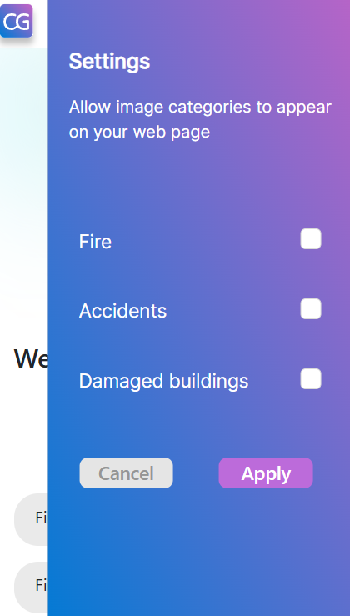
Our Extension
41

Slide 42
Challenges & How we solved them
Capturing data from the website and sending it to the back-end model for classification.
This process required injecting a script into the active tab of the browser.
Leveraged Chrome Extension APIs:
Employed a combination of chrome extension APIs.
One API facilitated retrieving information about the active tab, while the other enabled injecting our script into the active tab’s content.
Obtained Active Tab Details:
Used an appropriate API to acquire data about the currently active tab.
This data included the tab’s ID or handle, which is crucial for script injection.
Injected Our Script:
Armed with the active tab’s ID, we employed another Chrome extension API to inject our custom script directly into the content of the active tab.
This API allows us to execute JavaScript code within the context of the active tab.
42

Slide 43
Demo

Slide 44

Demo
44

Slide 45
Conclusion & Future Work
08

Slide 46

Goal
Create a safer environment for our vulnerable users that do not wish to be exposed to this type of inappropriate and violent content.
46

Slide 47
Performed sequence classification instead of token classification to be able to understand hidden meanings form inappropriate text.
Text Classification
Obtained
Image Classification
We've implemented two methods: binary and multiclass image classification.
Our filtration combines the parallel predictions of both models to determine the outcome.
47

Slide 48
Our Achievement
Our extension operates universally across all web pages, enhancing the browsing experience by filtering out inappropriate content from online sources, not just limited to social media platforms.
48

Slide 49
Future Work

Slide 50
Future Work
Improve Performance
Deploying the models
Enhance the accuracy of models while simultaneously reducing the latency of their predictions.
Deploy the models in the cloud to leverage the benefits of cloud computing infrastructure and services.
50

Slide 51
Future Work
Add Multilingual Feature
Text Recognition from Images
Enable the system to support multiple languages, expanding accessibility and enhancing user experience for a global audience.
Integrate the ability to scan and read text from images, enhancing functionality by detecting whether the text should be filtered.
51

Slide 52
References

Slide 53
[1] Monica, S. (2024, February). Text Datasets, Version 1. Retrieved December 20, 2023 from https://www.kaggle.com/datasets/monicasamehsalib/text-datasets.
[2] Bharadwaj, Vedadri Yoganand, Vasamsetti Likhitha, Vootnoori Vardhini, Adari Uma Sree Asritha, Saurabh Dhyani, and M. Lakshmi Kanth. "Automated Cyberbullying Activity Detection using Machine Learning Algorithm." In E3S Web of Conferences, vol. 430, p. 01039. EDP Sciences, 2023.
[3] SHIKAMARU. (2023, September). Toxic Comments Detection, Version 1. Retrieved December 24, 2023 from https://www.kaggle.com/datasets/shikamaru073/toxic-comments-detection.
[4] KARANDEEP, S. (2021, November). Real Life Violence and Non-Violence Data, Version 1. Retrieved December 20, 2023 from https://www.kaggle.com/datasets/karandeep98/real-life-violence-and-nonviolence-data.
[5] Abdul, M. (2023, November). Violence vs. Non-Violence: 11K Images Dataset, Version 1. Retrieved December 20, 2023 from https://www.kaggle.com/datasets/abdulmananraja/real-life-violence-situations.
53

Slide 54
[6] Rupak, R. (2022, March). Cyclone Wildfire Flood Earthquake Database. Retrieved February 10, 2024, from https://www.kaggle.com/datasets/rupakroy/cyclone-wildfire-flood-earthquake-database.
[7] KUTAY, K. (2021, July). Forest Fire. Retrieved January 25, 2024, from https://www.kaggle.com/datasets/kutaykutlu/forest-fire.
[8] Arash, F. (2022, June). Wildfire surveillance. Retrieved February 10, 2024, from https://www.kaggle.com/datasets/arashfarahdel/wildfire-surveillance.
[9] Amerzish, M. (2023, December). Forest Fire Smoke and Non-Fire Image Dataset. Retrieved February 20, 2024, from https://www.kaggle.com/datasets/amerzishminha/forest-fire-smoke-and-non-fire-image-dataset.
[10] JOÃO, G (2021, March). Fire Images Database. Retrieved February 20, 2024, from https://www.kaggle.com/datasets/gondimjoaom/fire-images-database.
[11] Cristian, C. (2021, July). FOREST FIRE IMAGE DATASET. Retrieved February 10, 2024, from https://www.kaggle.com/datasets/cristiancristancho/forest-fire-image-dataset.
54

Slide 55
[12] CHANGLU, G. (2023, December). AIDERdata. Retrieved January 25, 2024, from https://www.kaggle.com/datasets/clguo1/aiderdata.
[13] Yaroslav, C (2023, Feb). RescueNet. Retrieved February 20, 2024, from https://www.kaggle.com/datasets/yaroslavchyrko/rescuenet
[14] Almond, N. (2023, December). Ukraine Images 2023. Retrieved January 26, 2024, from https://www.kaggle.com/datasets/almondnguyen/ukraine-images-2023.
[15] Adel, Hadeer, Abdelghani Dahou, Alhassan Mabrouk, Mohamed Abd Elaziz, Mohammed Kayed, Ibrahim Mahmoud El-Henawy, Samah Alshathri, and Abdelmgeid Amin Ali. "Improving crisis events detection using distilbert with hunger games search algorithm." Mathematics 10, no. 3 (2022): 447.
[16] Koonce, Brett, and Brett Koonce. "MobileNetV3." Convolutional Neural Networks with Swift for Tensorflow: Image Recognition and Dataset Categorization (2021): 125-144.
[17] Tan, Mingxing, and Q. V. Le. "Efficientnetv2: Smaller models and faster training. arXiv 2021." arXiv preprint arXiv:2104.00298.
55

Slide 56
Thank You!

